Slide 1

Credit risk prediction system
Machine learning 600 assignment
Student name: Katlego Sambo
Student number: 402306874
Year: 2026
Semester: second semester
Credit risk prediction using machine learning and PCA
This Photo by Unknown Author is licensed under CC BY-NC-ND

Slide 2
Problem statement
Financial institutions need reliable approaches for evaluating credit risk, as poor lending choices can lead to economic losses or lost business chances.
Project objectives
Create a credit risk prediction system utilizing machine learning techniques
Categorize loan applications based on loan_status
Examine and prepare a real – world credit risk dataset for analysis
Utilize principal component analysis(PCA)
Examine three classification algorithms
Enhance the top performing model with GridSearchCV
Analyze the outcomes from a business viewpoint
Models evaluated
Logistic regression | K-nearest neighbours | Decision tree

Slide 3
Dataset overview
Dataset information
Item | Details
Dataset | Credit risk dataset
Observations | 32 581
Variables | 12
Target variable | Loan_status
Training set | 80%
Testing set | 20%
Main features
Personal details: age, salary and duration of employment
Ownership of a home and intent to borrow
Loan classification, loan value and interest percentage
Prior standard history
Duration of credit history
Include a brief remark
The dataset includes numerical and categorical variables, necessitating preprocessing prior to the application of machine learning models .

Slide 4
Data issues identified
MISSING VALUES
• person_emp_length: 895 missing values (2.75%)
• loan_int_rate: 3,116 missing values (9.56%)
TARGET VARIABLE IMBALANCE
• Class 0: 25,473 observations (78.18%)
• Class 1: 7,108 observations (21.82%)
POTENTIAL OUTLIERS
• Boxplots identified potential unusual numerical observations.
• IQR-based clipping was used during preprocessing.
CATEGORICAL VARIABLES
• Several features contained categorical information.
• One-hot encoding was applied before model training.

Slide 5
Data Preprocessing
1. Elimination of duplicates
Identical entries were recognized and eliminated
2. Handling missing values
Numerical variables -> imputation with median
3. Outlier management
Possible numerical outliers were addressed through IQR based trimming
4. Encoding categories
5. Scaling features
6. Divide into training and testing sets
Categorical variables were transformed through one-hot encoding
Numerical features were normalized utilizing standard scaler
80% training
Categorical variables -> imputation using the most common value
Scaling guarantees that attributes with varying numerical ranges can appropriately influence distance and scale sensitive algorithms
20% examination
Segmented based on loan_status

Slide 6
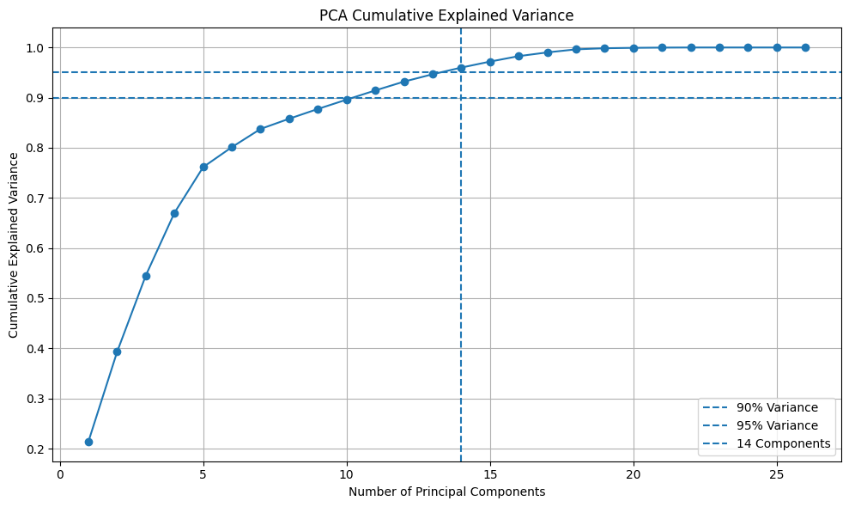
Principal component analysis
Purpose of PCA
PCA was employed to decrease the dimensionality of the processed dataset while preserving the majority of the information from the original features
PCA outcome
14 principal components
95.9935% variance retained
Crucial discovery
- Despite PCA maintaining around 95.99% of the variance, the classification effectiveness dimished for all three models post PCA

Slide 7
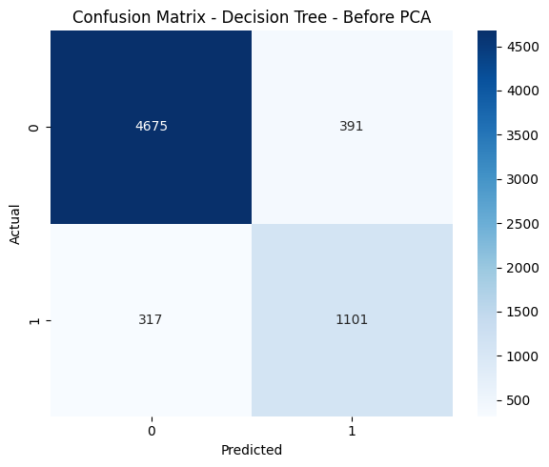
Model performance before PCA
Best performing model : decision tree
The decision tree obtained the best F1 score (75.67%) and the highest
recall (77.64%) prior to PCA
Recall is crucial in credit risk classification, as not recognizing a
risky applicant can lead to financial losses
Model | Accuracy | Precision | Recall | F1- score
Logical regression | 86.97% | 76.75% | 57.97% | 66.05%
K-nearest neighbours | 88.93% | 83.52% | 61.50% | 70.84%
Decision tree | 89.08% | 73.79% | 77.64% | 75.67%

Slide 8
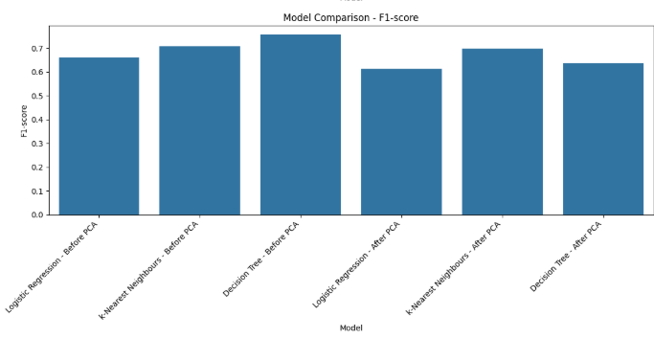
Model performance after PCA
Model | Accuracy | Precision | Recall | F1-score
Logistic Regression | 85.86% | 76.18% | 51.41% | 61.39%
k-Nearest Neighbours | 88.49% | 81.88% | 60.86% | 69.82%
Decision Tree | 83.82% | 62.47% | 65.16% | 63.79%
Model performance after PCA
It is especially beneficial because it displays both before PCA and after PCA, enabling the performance variation to be observed directly
PCA diminished the classification effectiveness of all three models in relation to their originally processed features.
Even though 14 main captured about 95.99% of the variance , the initial processed features delivered superior classification results.

Slide 9
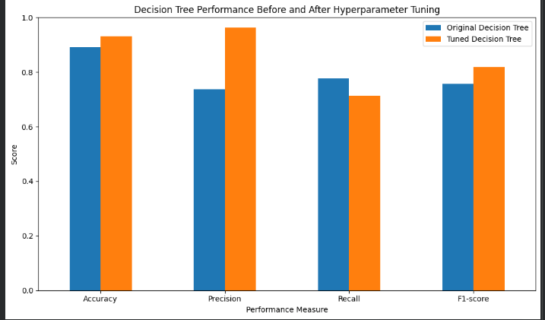
Hyperparameter optimisation
Best parameters
criterion: entropy
Maximum depth: 10
Minimum samples leaf: 2
Hyperparameter Optimisation
Search Process
GridSearchCV with 5-fold cross validation was used to optimise the decision tree model
Investigative procedure
108 combinations of parameters evaluated
540 total model fits
Assessment metric: F1-score
Cross validation: 5 fold

Slide 10
Conclusion and business insights
Project conclusion
The credit risk prediction system was successfully created using logistic regression, k-nearest neighbours and decision tree classification models.
2. Main findings
The dataset comprised 32,581 entries and 12 variables
PCA preserved 95.99% of the variance with 14 components
Features that were processed originally outperformed those that were transformed using PCA
The initial decision tree reached an F1 score of 75.67%
Hyperparameter optimization enhanced the decision tree, achieving a final test F1 score of 81.91% and an accuracy of 93.12%
3. Business insight
A credit risk system needs to account for factors beyond just accuracy. False negatives a crucial since misclassifying a high risk applicant as low risk might put a financial institution at risk of incurring losses
In this experiment the optimized decision tree demonstrated the best predictive performance and is consequently chosen as the final model
Final Model: Tuned Decision Tree | Accuracy: 93.12% | F1-score: 81.91%

